Slide 1
Materials presented are for general informational purposes only and do not constitute official University rules, policies or practices or interpretations or summaries of such rules, policies or practices. No warranties or representations are made as to the accuracy of any information presented. Any discrepancy between the information presented here and the official rules and policies of the University of Oregon is not intended to and does not alter or amend the official rules and policies.

Slide 2
Preparing Promotion and Tenure Files
Department Heads, Office Managers, and Key Support Staff
Ken Doxsee
Vice Provost For Academic Affairs
February 18, 2016

Slide 3
Overview
Timelines
Constructing the dossier (guidance on components)
The supplementary file
Digital dossier submission

Slide 4
P&T Process and Timetable
Preliminary Work
Department Head notifies faculty of requirement for upcoming review (required tenure decision)
Candidate discusses with Department Head (optional tenure decision, promotion to full)
Candidate’s contributions to the process
Identification and solicitation of external reviewers
Department Review
Personnel Committee – usually report and vote
Vote by voting faculty (signed, secret ballot)
Department Head report and recommendation
Winter of
previous year
Spring of
previous year
Early Fall

Slide 5
P&T Process and Timetable (continued)
Fall / Winter
School/College Review
Personnel or Advisory Committee (elected) – report and vote
Dean – report and recommendation
University Review
Faculty Personnel Committee (elected) – report and vote
Provost – review and decision
Winter / Spring
Decision announcement target date: May 1

Slide 6
P&T Deadlines
September 15
Deans submit to Academic Affairs a list of those in the school/college being considered for promotion and/or tenure (can be revised).
November 15
College of Arts and Sciences (CAS) departments submit completed files to Dean.
November 30
All units (excluding CAS) submit tenure cases to Academic Affairs.
January 15
All units (excluding CAS) submit remaining cases to Academic Affairs.
March 15
CAS submits all cases to Academic Affairs. Essential, however, for the vast majority of CAS files to be submitted prior to this date.

Slide 7
Constructing the Dossier
{A review in the approximate order of its construction}
http://academicaffairs.uoregon.edu/promotion-tenure

Slide 8
Election of Criteria
Pre-tenure candidates:
If there has been a change in the written criteria for promotion and/or tenure since the time of hire, the candidate may choose (and should establish in writing) which criteria document will apply.
Tenured candidates:
The above is limited to the preceding 6 years.

Slide 9
Candidate’s CV
Signed and dated
Updates permissible – prefer simple list of updates (signed and dated) rather than a full updated CV
Always include the CV as seen by the external reviewers as well as any updates
Format – disciplinary norm
Full profile (including teaching and service)
Include graduation dates, mentor’s names
Include section for work in progress
“The Book”
Signed contract, manuscript complete and accepted, with no further revision (copy edit/galley proof can be pending)

Slide 10
Candidate’s Statement
Signed and dated
Updates permissible
Always include the statement as seen by the external reviewers as well as any updates
Accomplishments, current activities, and future plans for research, teaching, and service
Statement regarding contributions to institutional equity and inclusion
Help the reader understand anything “unusual”

Slide 11
Statement of Waiver
File must contain signed and dated statement by candidate
Retaining full access, or
Waiving all rights of access, or
Partial waiver
This statement must be completed prior to request for external evaluations
Templates available on Academic Affairs web site

Slide 12
Statement of Duties & Responsibilities
Objective statement
Purely factual
Increasingly common practice – provide copy of position description

Slide 13
“Conditions of Appointment” Section
Tenure cases – most recent contract
Promotion to full professor – nothing required
Official letters of understanding
evaluation procedure for “split” appointments
limited range of activities on which promotion will be based
credit granted for prior service at other institutions
extended time for tenure for reasons such as pregnancy or childbirth

Slide 14
“Teaching Evaluations” Section
Courses (large, small, seminar)
Curriculum development
Student supervision, advising, etc.
Hires from other institutions
Recognize that some materials may not be available
Attempt to include as comprehensive a package as possible

Slide 15
Teaching – Department Responsibilities
List of courses taught
Summary table – quantitative evaluations (including class size, percent response, departmental comparison data)
Sample evaluation form
Copies of all quantitative summaries
Copies of all signed qualitative comments (in supplementary file)
Peer evaluations
Pre-tenure: at least one in each of years 3, 4, and 5
Tenured associate professor: at least one every other year

Slide 16
Teaching – Candidate’s Responsibilities
List of teaching awards
List of supervised students, sorted by kind and including dates and role (e.g., chair, advisor, committee member)
Postdoc, doctoral dissertation, masters thesis, honors thesis
Teaching portfolio
In supplementary file
Syllabi, innovative materials (including electronic), etc.
Illustrative, not exhaustive

Slide 17
Letters from Students
Include both solicited and unsolicited student letters, but only if signed and dated
Student letters are not required
Inundation is not needed or desirable

Slide 18
Supplemental File
Supplemental teaching evaluation data
One set of printouts and signed statements. Unsigned narrative student evaluations are unacceptable and should not be included in the file. It is illegal to quote from unsigned evaluations in summary statements prepared for the file.
Scholarship portfolio
Teaching portfolio
Service portfolio
(Evidence of contributions to equity and inclusion)
(“typically includes”)

Slide 19
Letters of Evaluation
Candidate – list of suggestions
Department – independent list
If candidate suggests reviewer on department list, that reviewer NOT listed as “suggested by the candidate”
Reviewers at or above the rank being sought, at comparable institutions
Department selects external reviewers
Clear majority of “untainted” reviewers – be proactive and reactive
Requested by department head via standard form letter
Templates available on Academic Affairs web site
Include example of each letter in the dossier

Slide 20
Letters of Evaluation (continued)
Reviewers must be notified in advance regarding waiver status
Include both solicited and unsolicited letters
All letters received must be included in the file
Written declinations included at the end of section
Reconcile letters received with list of letters solicited on the Promotion and Tenure Checklist
Place unsolicited letters AFTER solicited letters
Letters from students on teaching and supervision belong in teaching section

Slide 21
List of Materials Sent to Reviewers
Candidate’s Statement
Candidate’s Vita
Published Work (during period under review) – list
Selected works in progress may be included – list
Unit’s Promotion and Tenure Criteria

Slide 22
Biographical Sketches of External Reviewers
Short but complete, with description of the person and their standing in the field, relationship to the candidate, and whether suggested by the candidate or chosen by the Department.
Do not include vitas here; provide in supplemental file.
Noam Chomsky, Professor of Linguistics, MIT
Chomsky is one of the three or four most important scholars of linguistics in the 20th century. He is the originator (along with his teacher Zellig Hams) of the theoretical framework for linguistic analysis known as “generative linguistics.”
Chomsky has no known relationship to the candidate.
Selected by the Department

Slide 23
Departmental Committee Recommendation
Analysis, not just information from the vita
Strengths and weaknesses relative to department and discipline standards
Fully present all aspects of the case – analysis, not advocacy
Context for scholarship/creative practice
Ranking, status of journals, publishers, venues, etc.
Peer reviewed vs. not
Comments on the stature of the external referees
Other information relevant to appraising the candidate’s work
Research grants, fellowships, etc., if normal to the field
Not size or number of awards but recognition by rigorous competitive review
Discrepancies in publishing and/or funding record

Slide 24
Departmental Committee Recommendation (cont’d)
Analysis of candidate’s record of teaching
Statistical data from student evaluations
Address anomalies
Comparisons with rest of department and/or faculty teaching courses of similar size, character or content
Evaluative summary of signed written students comments
Review and comment on teaching portfolio
Discrepancies between student and peer evaluations
Analysis of the candidate’s record of service
Report must be signed by all members of the committee

Slide 25
Department Head’s Evaluation
Administrative summary of the department’s position on the case
Brief explanation of department’s review process
Clarification of special conditions, duties or obligations
Explanation of who votes
Summary of faculty discussion preceding official vote
Departmental votes secret; only tally revealed to faculty and recorded on voting summary sheet
Explanation for abstentions or recusals
Justification for an earlier-than-usual process
Independent review and appraisal of the case
Report must be signed

Slide 26
School/College Personnel Committee Report
“Secondary reviewers” – in general, lack expertise to review and evaluate the scholarship; focus on overall record, external reviews, and departmental reports
Criteria employed are those of the school /college /unit
May request additional information, including additional outside letters
Committee’s vote recorded and part of the file forwarded to Academic Affairs

Slide 27
Dean’s Evaluation & Recommendation
Independent from department level review – analysis of qualifications relative to school/college standards
Attempt to address any issues that have been overlooked
In early cases, discussion of exceptional merits of case

Slide 28
Dean’s Meeting
Dean (or associate dean, if designated) meets with candidate prior to submission of file to Academic Affairs
Information presented in the departmental report
General content of outside letters
Summary of recommendations made to date, including Dean’s
Three days’ notification of meeting required
If member of bargaining unit, candidate may bring non-participating observer or non-participating representative from United Academics

Slide 29
Dean’s Meeting (Continued)
Candidate may request redacted copy of Dean’s report, redacted in accordance with waiver status (Academic Affairs can assist)
Requests for any other materials – consult with Academic Affairs
10 days allowed for candidate to provide written response

Slide 30
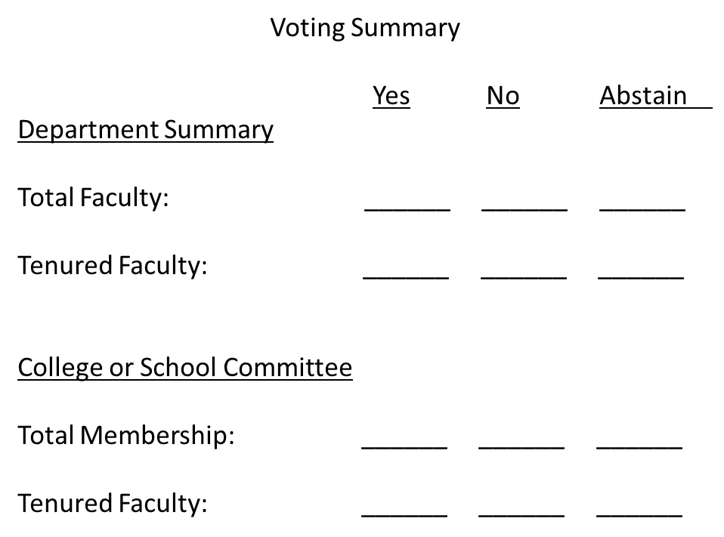
Voting Summary

Slide 31
P&T Checklist

Slide 32
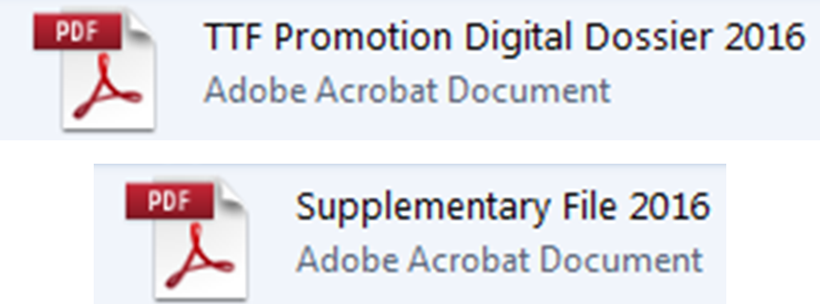
The Digital Dossier
Adobe Pro
https://casit.uoregon.edu/training/adobe-acrobat
Make copies
Rename
Doxsee, Kenneth (Chemistry) P&T Dossier
Doxsee, Kenneth (Chemistry) Supplementary File

Slide 33
The Digital Dossier

Slide 35
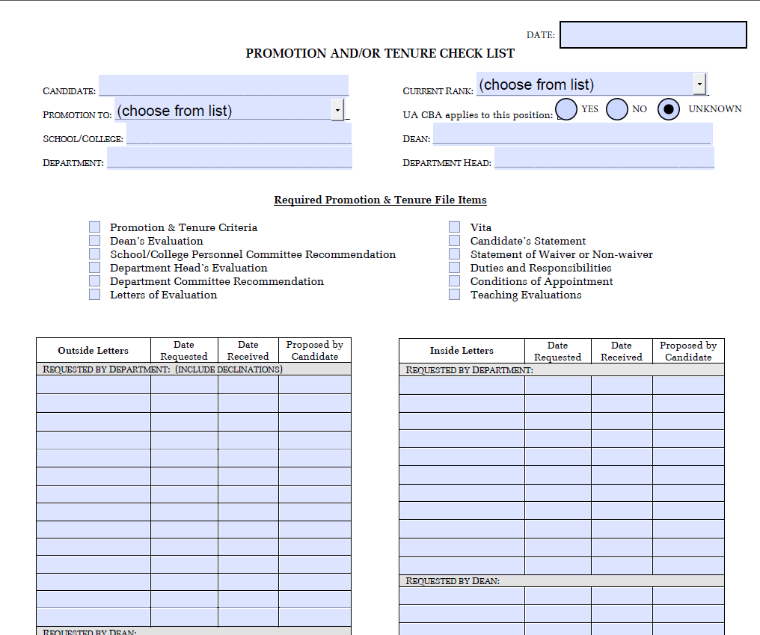

Slide 36
The Digital Dossier

Slide 37
Double click the icon (not the name) of the desired section.

Slide 39
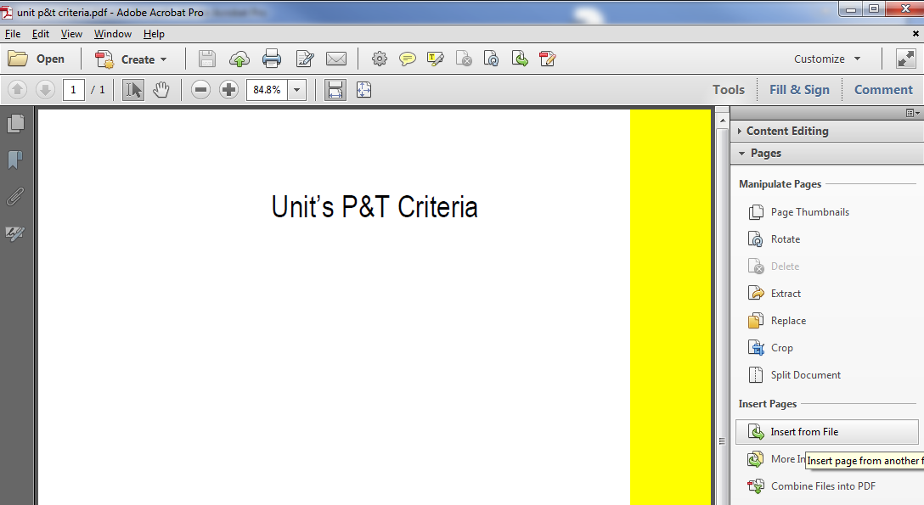

Slide 41
The Digital Dossier

Slide 42
Fillable Forms
P&T Checklist
Voting Summary
Contents for Evaluation Letters Section
Teaching Checklist

Slide 43
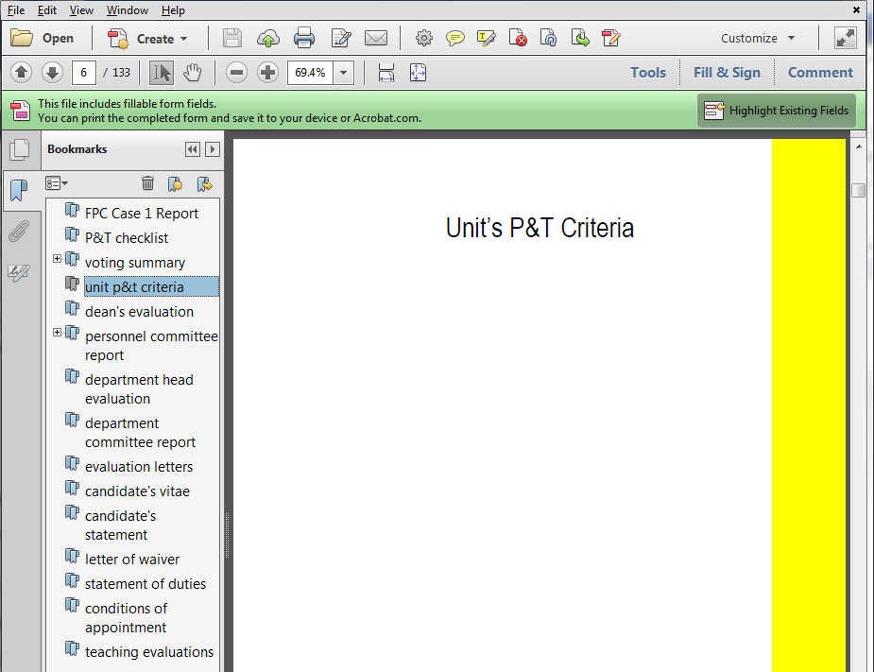
The Digital Dossier

Slide 44
The Supplementary File

Slide 45
The Supplementary File
Materials not conveniently provided in digital form
Provide in conventional format

Slide 46
Submission of Digital Dossiers
Notification of Academic Affairs in advance (as always)
Submission of the digital dossier
In-person via USB drive
Plan – secure web site (stay tuned)
Archiving
Academic Affairs requires no hard copies
Dean and/or Unit Head may choose to create hard copy

Slide 47
Questions
Ken Doxsee
Vice Provost for Academic Affairs
346-2846
doxsee@uoregon.edu

